Slide 1

SANeForce – SFA,DMS
San Media Private Limited was incorporated in the year 1992. Having it’s headquarter located in Chennai, India.

Slide 2

SANeForce SFA + DMS
(A division of SANmedia Ltd., Since 1992)
Providing SFA and DMS product and Services to Fast Moving Consumer Goods
Award winning, customer satisfaction and customization innovative technology
75,000+ Users
Distributors
Product Promoters
Retailers & Influencers
Merchandisers
20+ years of service
Front line Sales Reps
Global Presence
Field Force Managers

Slide 3





i
Major modules implemented for Milk Product Client (HAP)
Single sign up across multiple platforms (SFA, DMS, Payroll, SAP)
ERT (Emergency Rescue Team) Setup and Implementation
SAP Integration (import Master, Export Sales)
Expense and Travel Allowance Management (at a high level)
Payment module – Wallet and payment gateway
IoT Ready – Software integration with printers, barcode and QR scanners. (gate entry exit system)
Auto Block ID if not in use
Payment Ledger – Tracks Distributor’s and Retailer’s Collections.
Team tracking – track all members of a team in a single instance in the map.
Cut off timer for distributor for placing orders.
Field Asset Tracking – 1 lakh+ freezer box (with model specs), TV, Desktop
Tracking and model spec reading using barcode
Identifying nearby retailers using google location finding feature.
Last 3 months analysis of retailer’s purchase trend.
Repeat Order possible

Slide 4
Sales Strategy - SFA
01
02
03
FOCUS ON KEY CUSTOMERS
NEW OUTLETS
IN-STORE MARKETING
04
PROMOTIONS AND REWARDS
05
CUSTOMER ENGAGEMENT
06
IN-STORE SELLING

Slide 5
SFA Flow
Login-Check in
Tour Plan entry and approval
My Day plan (Plan of Action)-based on Tour Plan
Order Entry-Primary and Secondary
Order Process
Order view, Edit and deletion
Order sharing through WhatsApp/Mail
New customer enrollment (with edit and delete options)
Geo Tagging and Fencing
Multi beat plan in same day
Team Tracking (Manager App)
Offline order entry
Leave form
Expense entry (Manual and Automatic)
Approval (Manager App)
Closing stock entry (Distributor and Retailer)
Reports

Slide 6
DMS Flow
Login
Sales invoice process
Purchased order Request
Dispatch
summary
Payment process
to company
Closing stock
GRN entry
Reports
Retailer order entry

Slide 7
Customization
Additional modules and reports can be delivered time to time.
Customizations will be done as per requirement
Compatibility – Ease of use
Barcode/QR Code Scanner Integration
3rd Party Integration
iOS
Android
Microsoft Windows
Biometric Integration
Printer Integration

Slide 8
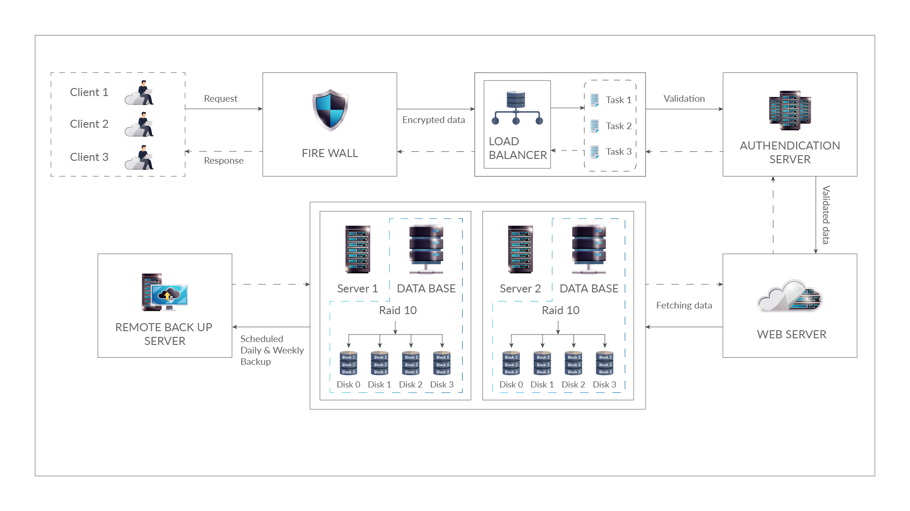
System Architecture

Slide 9
Business Analyst to understand requirements
Timeline
Updates
Consistency – Setup and implementation
Data Migration
Customization features
Master Creation
Tech Support
Pilot

Slide 10
Commitment
Training in person
Issue Handling – Ticket system
Live online training
Long term commitment
Support Documents
Multi Lingual support
Recorded videos
Support – Whatsapp, email, call, video conference
Flexible timings

Slide 11
Support Mechanism
Master Data uploading, Site creation and back up configuration, Security and Firewall Set up, Bandwidth Allocation, Training
Direct and online Training to Field Force managers and admin
Dedicated and priority support to Admin anytime.
Providing User Manual (Video, PPT) to all the field force.
Live Online Training and Direct Training to field force.
Ticketing system
For the effective implementation, we are offering the following support
Phone Support – 24hrs Multilingual support to field force.
Live Chat facility
Email Support
WhatsApp Support to field force and admin

Slide 12


Top Customers
5000 users
1200 users
800 users
800 users
500 users
400 users
150 users

Slide 13
Future Developments
01
Report Generating Tool
02
Business Intelligence and Analytics
03
Procurement app – procuring suppliers for milk industry
04
AI enabled CRM Software
05
HR management system

